Slide 1
Book Recommendations System

Slide 2
Mentors And Team Members
Mentors
Dhanyapriya Somasundaram
Karthik Muskula
Team Members
Ashish Shinde
Disha Sharma
Dhiraj Navale
Jayesh Patil
Pournima Kotgiri
Shaheen Begum

Slide 3
Contents
Project Architecture
Introduction to Recommendation System
Data set Details
Data preprocessing and Eda
Visualization
Details about recommendation techniques
Model selection
Deployment

Slide 4
Project Architecture
Datasets
Data Cleaning
Model Deployment
Data Visualization
Model Selection
Import Libraries
Load Data-sets
Missing Value Treatment
Numerical Data Visualization
Barh Chart, Pie-Chart, Bar Graph, Histogram
Outliers Detection through Boxplot
Checking duplicates
Data Preprocessing / EDA
Rename column names
Construct an extra column for the location
Changes in the inappropriate blanks values in columns

Slide 5





2. Introduction To Recommendation
Recommendation systems involve predicting user preferences for unseen items.
Recommendation systems have become very popular with the increasing availability of millions of products online
Recommending relevant products increases the customer’s interest and sales of the company.
Examples:-
Facebook-” People You May Know”
Netflix-” Other Movies You May Enjoy”
Amazon-” Customers Who brought this item also brought…”

Slide 6
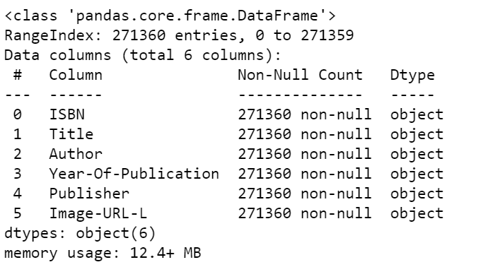
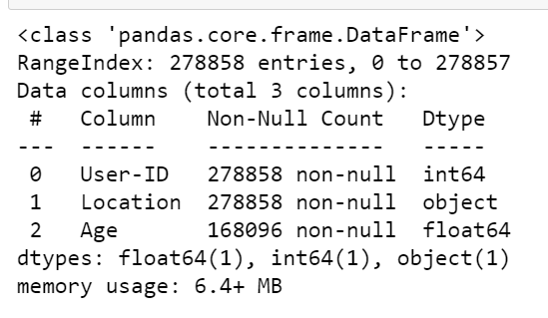
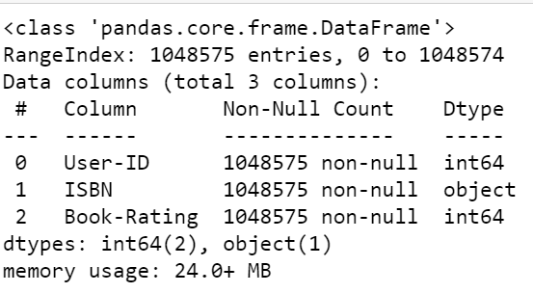
3. Datasets Details
Book Dataset
No. of rows:-271360
No. of columns:-8
Users Dataset
No. of rows:-278858
No. of columns:-3
Rating Dataset
No. of rows:-1149780
No. of columns:-3

Slide 7
4. Data Preprocessing
In Users Dataset
In the Users dataset in the Age column we find unique values and with that, we calculate the mean age.
In the Location columns, we have combined information about the city, state, and country we split this information into three different columns.
In Rating Dataset
In this data set we check Book-rating and User-Id are columns that are numerical type.
In the ISBN column we remove extra characters.
In Books Dataset
Checking of null values and missing data.
Removal of two columns of small image URL and large image URL.
Changing column names for easy recognition.
In the publisher column missing value with others.
In the Year Of Publication column we have two object data DK Publishing Inc replaced this with 2000 and Gallimard replace it with 2003.

Slide 8
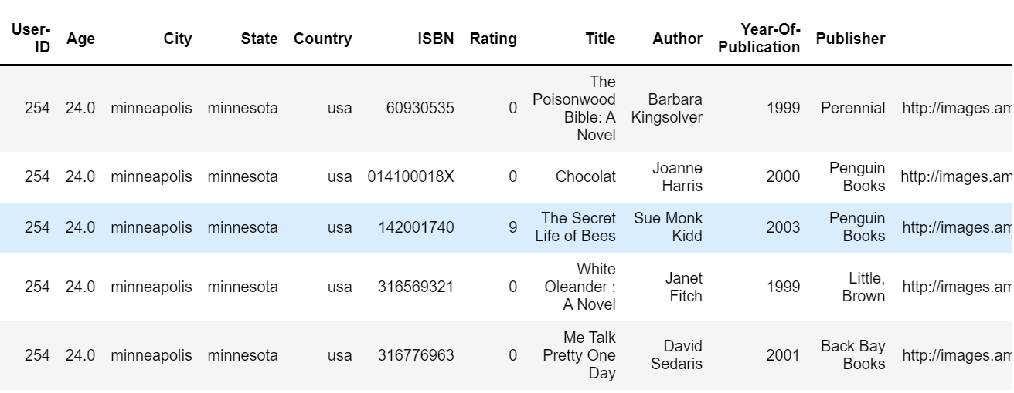
Final Dataset Details
After applying preprocessing on all three datasets. We merge all and made the final data set for visualization and model building.
Datasets
Final Dataset
Rows And Columns
50815 Rows
8 Columns
No. Of Unique User-ID
95513
Null Values
Data Types
Total null values of all 3 datasets are6
Int(32) 1 columns
Object 8 columns
After merging of all three preprocessed datasets

Slide 9
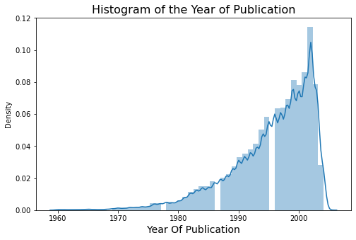
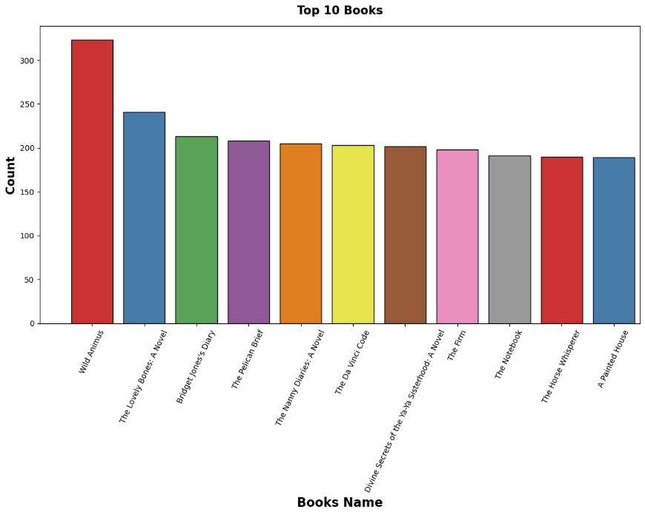
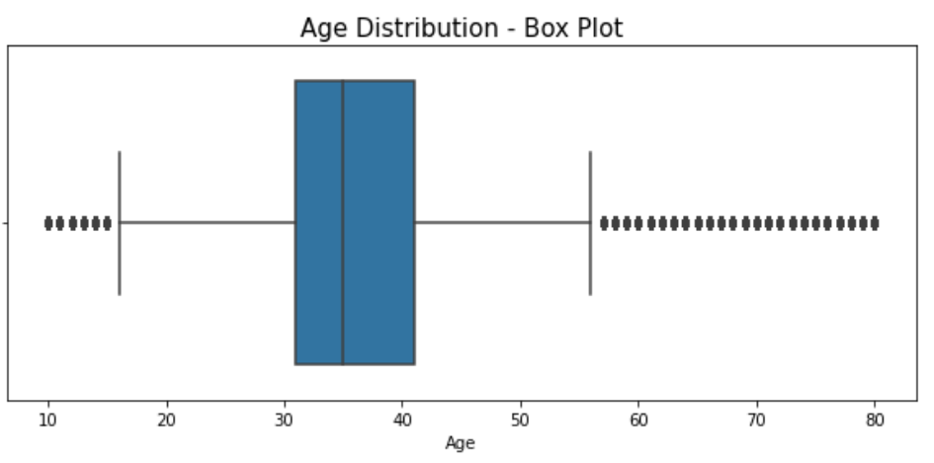
5. Visualization
In Histogram represents the Year Of Publication
From 1990 to 2005 we saw there are many publishers.
Graphical representation of top 10 books
Outliers
There are many outliers in age columns
Outliers are treated with mean values.

Slide 10
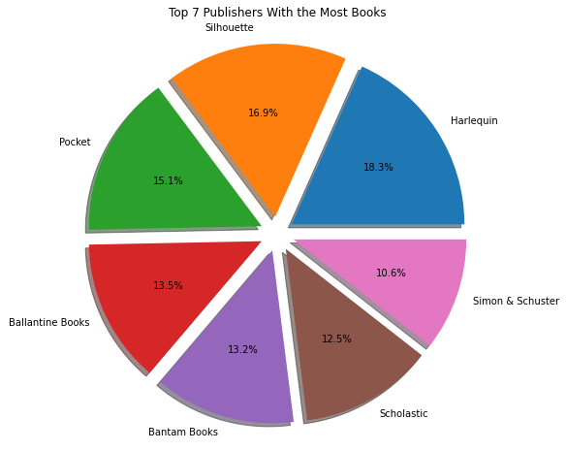
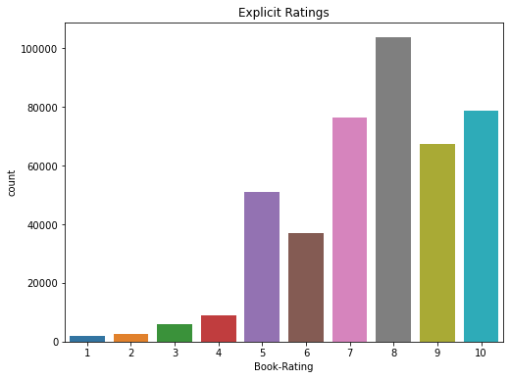
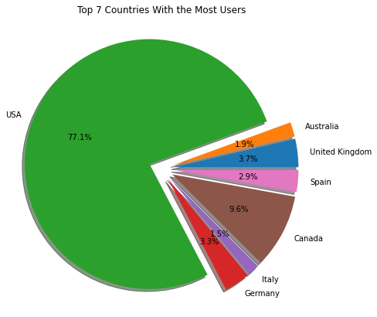
Top 7 Publishers With the Most Books
Divide the complete dataset based on implicit and explicit ratings.
In the Explicit dataset we get a rating above zero
In the Implicit dataset we get a rating of zero.
So we select the Explicit dataset.
In Explicit rating we find that more people rated above 6 and most of the people rated 8.
Top 7 Countries With the Most Users

Slide 11
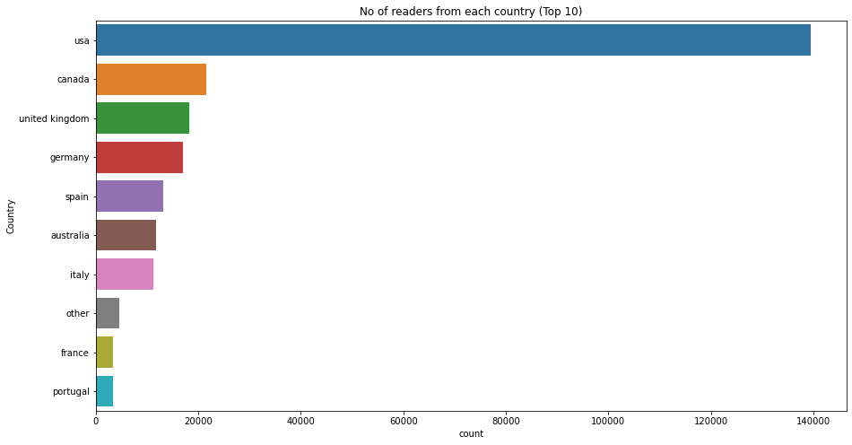
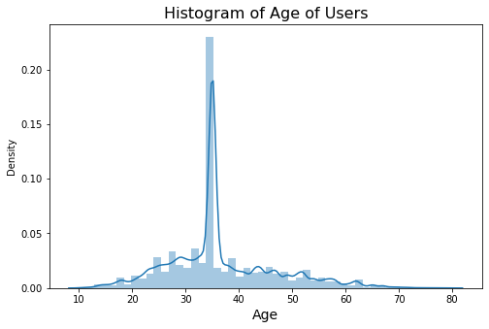
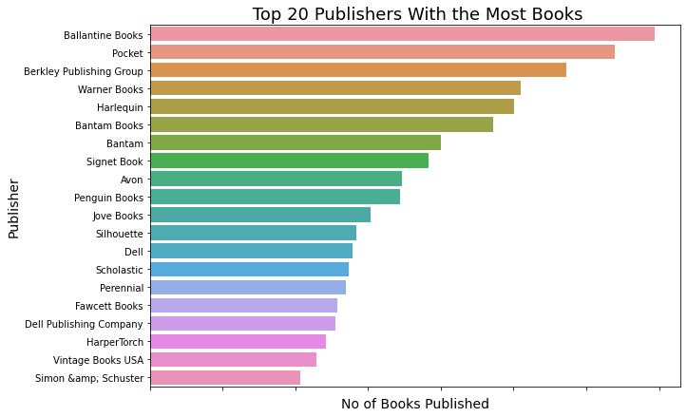
Below Histogram Represents the age of users.
Top 15 Highest Reader From Countries
Aged between 30 to 40 most users read books.
Top 20 Publisher With The Most Book

Slide 12
6. Recommendation Techniques
6.1 Popularity-Based Recommendation System :-
It is a type of recommendation system which works on the principle of popularity and or anything which is in trend. These systems check the product, movies, or books that are in trend or are most popular among the users and directly recommend those.
Advantage of popularity-based recommendation system
There is no need for the user’s historical data.
Disadvantage popularity-based recommendation system
The system would recommend the same sort of products/books which are solely based on popularity to every other user.

Slide 13
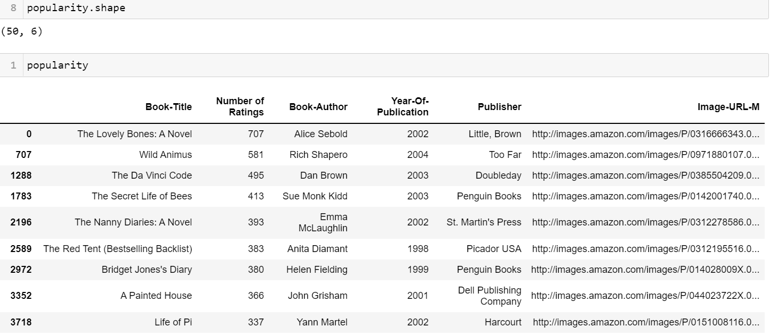
Popularity-Based Recommendation System Dataframe

Slide 14
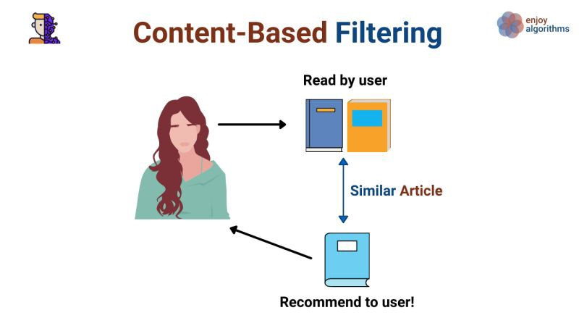
6.2 Content-Based Filtering:-
A content-based recommender works with data that the user provides, either explicitly (rating) or implicitly (clicking on a link). Based on that data, a user profile is generated, which is then used to make suggestions to the user.
Advantage of content-based recommendation system
Able to recommend users with unique tastes.
Can explain the recommendation.
Disadvantage of content-based recommendation system
Data should be in a structured format.
Unable to use quality judgments from other users.

Slide 15
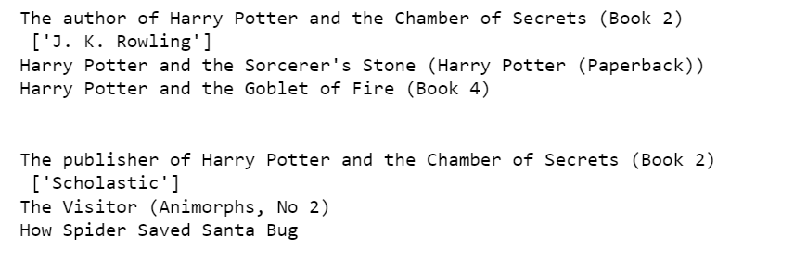
Content-Base Filtering Result

Slide 16
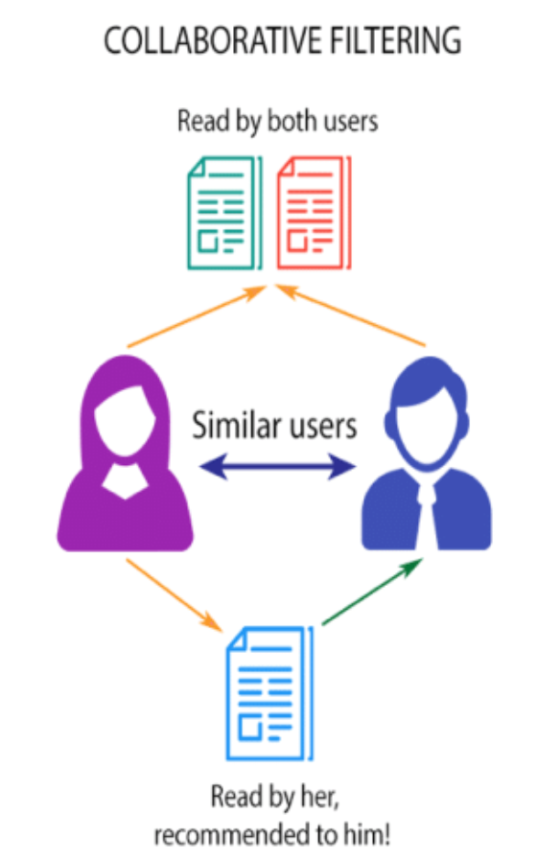
6.3 Collaborative Filtering:-
Collaborative filtering is used by most recommendation systems to find similar patterns or information of the users, this technique can filter out items that users like on the basis of the ratings or reactions by similar users.
Advantages of collaborative filtering
Other user scores are used.
No deterministic result since chance is involved in the system.
Disadvantages of collaborative filtering
Needs more data.
Problems with new users and new products.

Slide 17
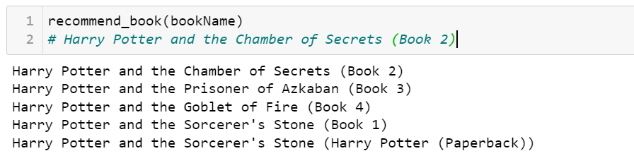
Result Of Collaborative Filtering

Slide 18
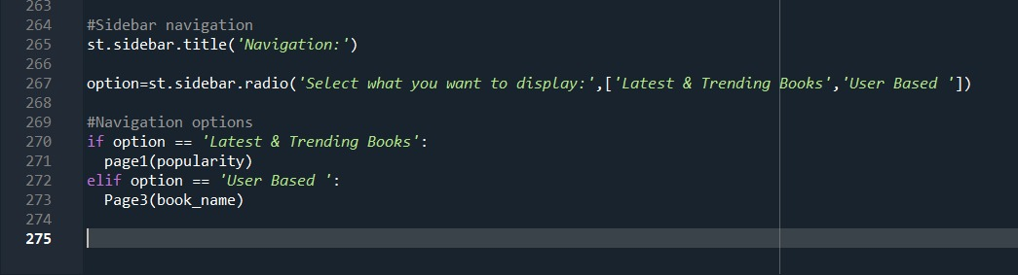
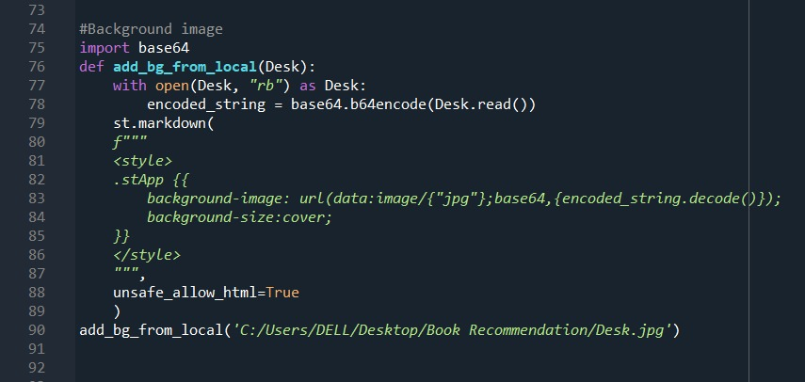
8. Deployment
Deployment is the process by which a ML model is moved from an offline environment and integrated into an existing production environment, such as a live application. It is a critical step that must be completed in order for a model to serve its intended purpose and solve the challenges it is designed for
Using Streamlit we have deployed our application
Sidebar Navigation
Background Image

Slide 19
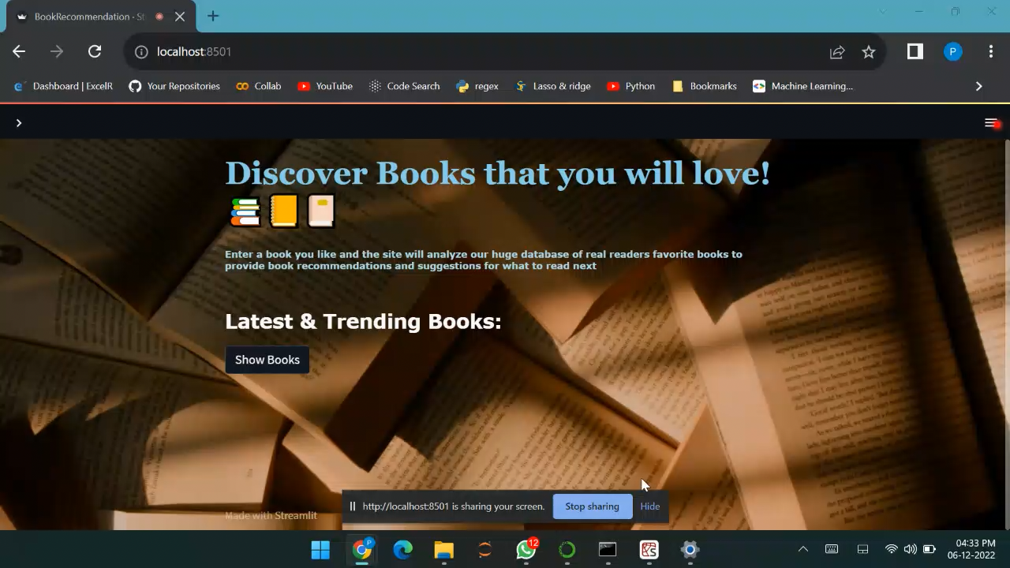

Slide 20

CHALLENGES IN PROJECT
In Start, we face difficulty with the dataset we have three datasets in that multiple columns are interlinked with each other. In that pre-processed data and finds the relationship between variables.
EDA is an interesting part but the selection of variables and making more effective visualization is quite a tough task
A most difficult task for the team to build an accurate model, we made 5-6 models and selected only three that show accurate recommendations.
In deployment, we learned streamlit and HTML for making a good interface. It takes time and continuous discussion in the team and we did make a great app page.

Slide 21
References
Pandas documentation link:- https://pandas.pydata.org/docs/getting_started/index.html
Matplotlib documentation:- https://matplotlib.org/stable/index.html
Streamlit documentation:- https://docs.streamlit.io/library/get-started/main-concepts
Kaggle.com
KNN documentation:- https://scikit-learn.org/stable/modules/generated/sklearn.neighbors.KNeighborsClassifier.html

Slide 22
Thank You

